Slide 1
Salary Survey Data Analysis Project-Milestone-1
Prepared by : Kamatchi Lalitha.R
Course : DA & DS
Batch : June -25

Slide 2
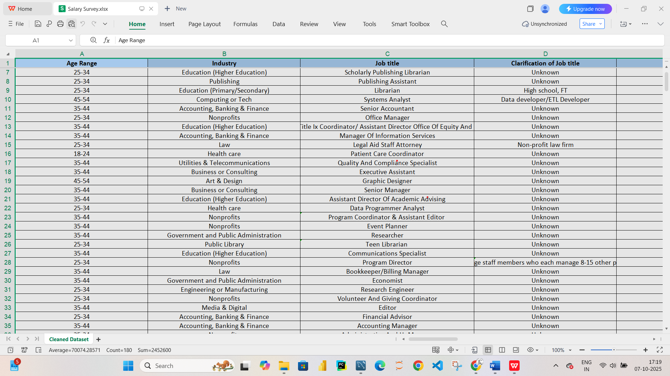
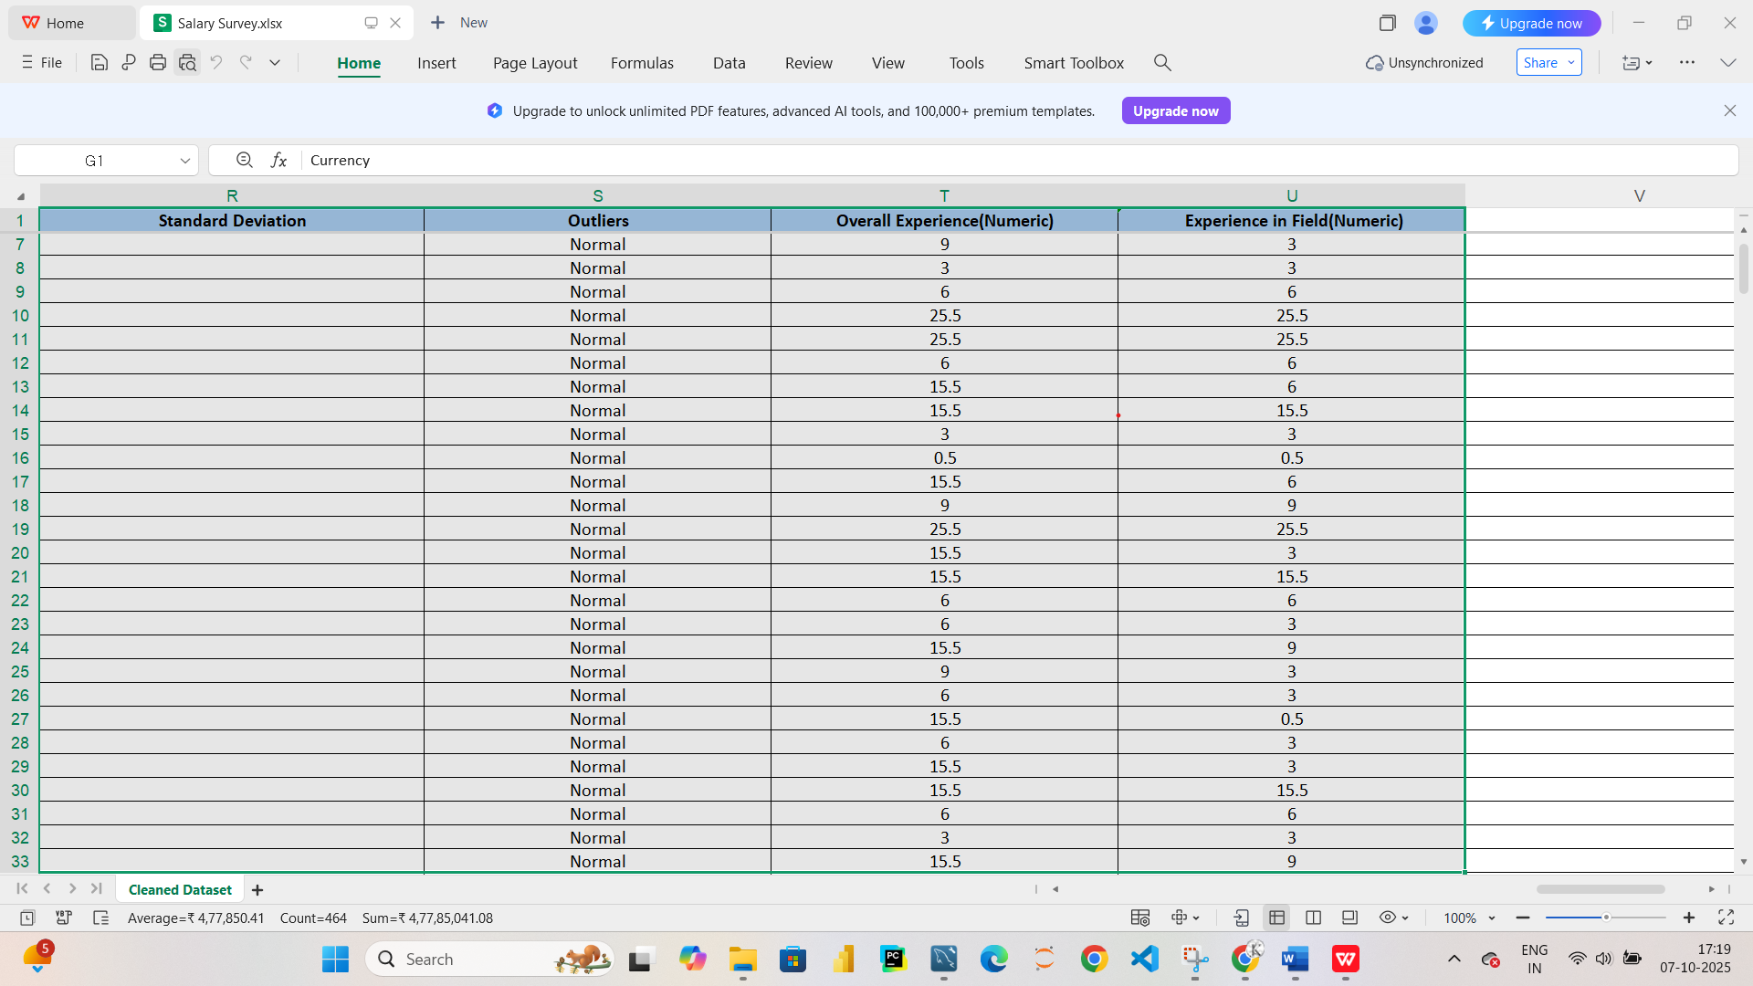
Project overview
The dataset captures employee information such as salary, education, experience, gender, and industry.
Purpose: Identify pay disparities, compensation drivers, and outliers.
Tools: Excel for data cleaning, SQL for querying.

Slide 3
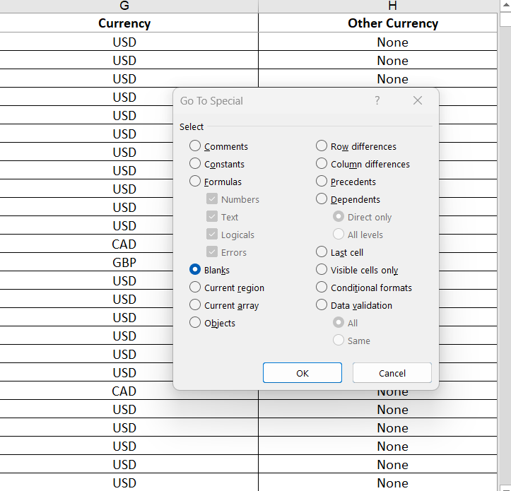
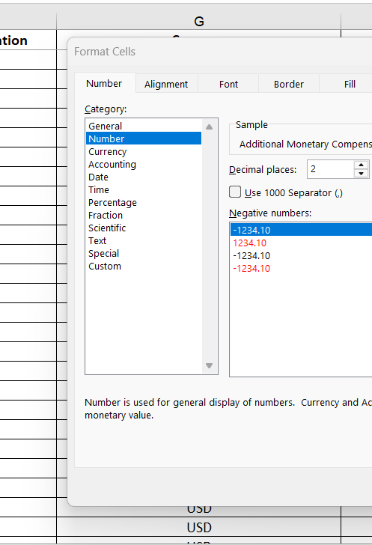
Data Cleaning & Preparation
Removed nulls and duplicates to ensure integrity.
Standardized data types.
Converted salary data to numeric format.
Ensured consistent currency and units across records.

Slide 4
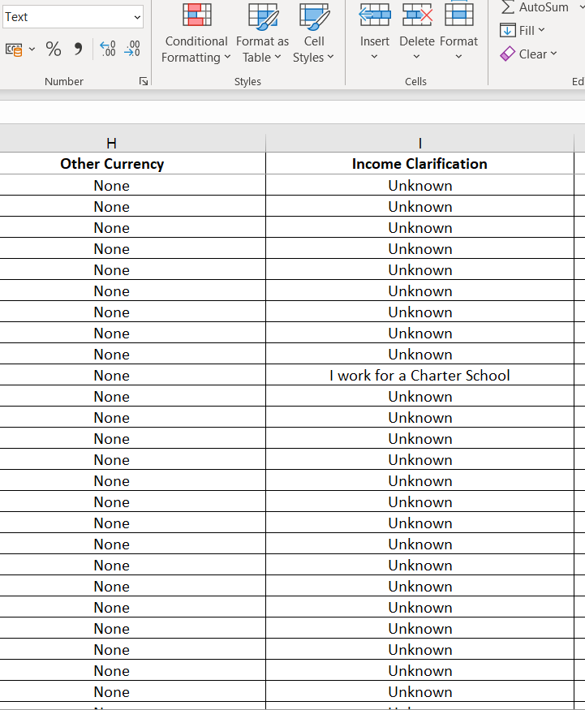
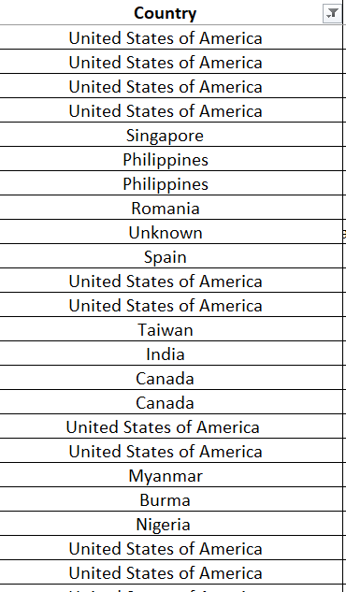
Handling Missing values
Before Cleaning
Columns like Other Currency and Income Clarification had many missing or unclear entries (None, Unknown).
Some text entries were non-numeric (e.g., “I work for a Charter School”).
Cleaning Steps
Replaced None / Unknown with blank or NULL values.
Dropped columns with repetitive data (like Other Currency).
Verified numeric data types for consistency.
Result
Reduced data noise and improved accuracy. Dataset ready for visualization and further analysis.

Slide 5
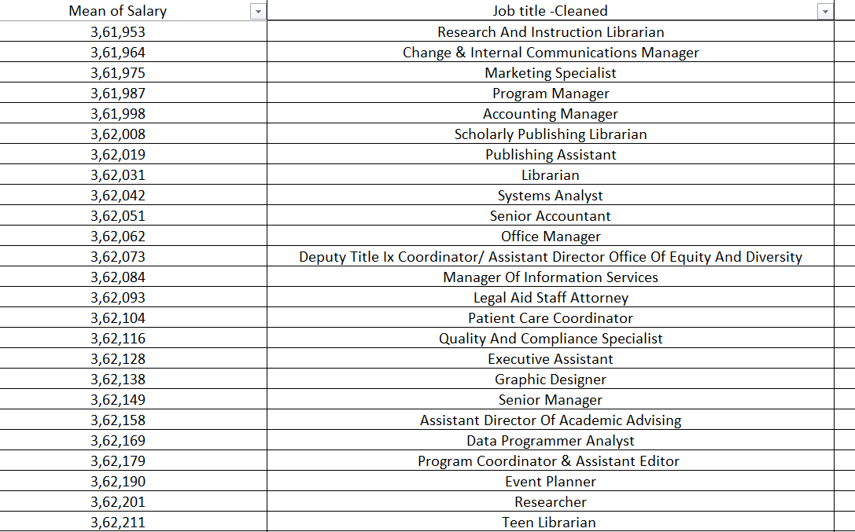
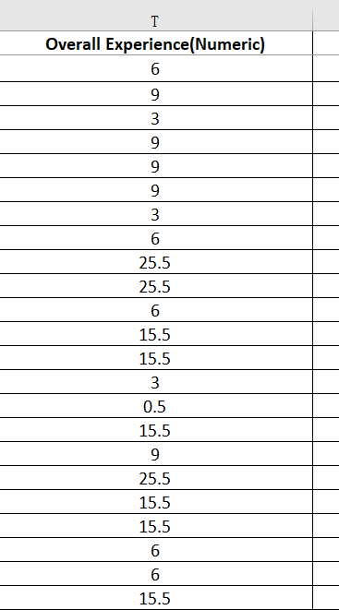
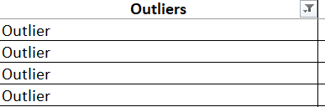
Descriptive Statistics
Mean Salary: ₹3,61,953
Standard Deviation: ₹36,196,596.02
Formula for Outlier Detection:
=IF(ABS(B2-$N$2)>3*$P$2,"Outlier","Normal")
Insight:
→ Extremely high SD indicates large variation or inconsistent data entries.
→ May contain exceptionally high salaries or incorrect values.

Slide 6
PROCESS OVERVIEW
Data Import:
Imported Salary Survey dataset (CSV) into MySQL for structured querying.
SQL Analysis:
Executed 10 analytical queries to extract insights such as:
Average, minimum & maximum salary by Education Level
Salary by Job Title and Experience
Salary distribution by Gender and Country
Top earning Industries & Roles
Count of respondents by category

Slide 7
Data Export & Visualization:
Exported query results to Excel.
Created 10 charts including bar, line, and pie charts.
Dashboard Creation:
Combined visuals into an interactive dashboard using slicers and KPIs.
Added filters for Education, Job Title, and Experience to view insights dynamically.

Slide 8
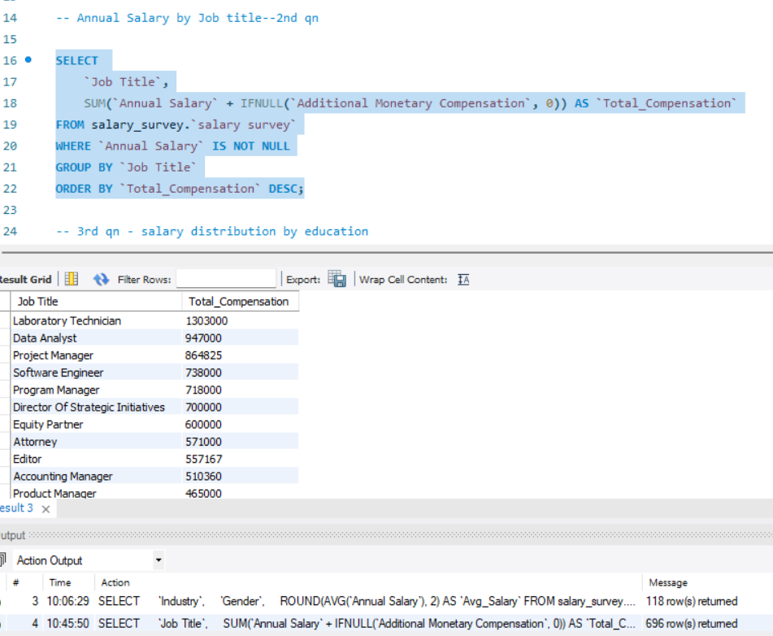
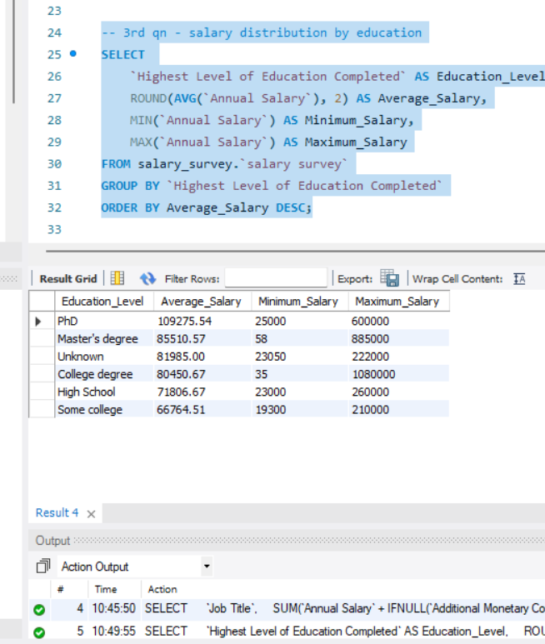
Imported Excel to sql, CREATED DB,TABLE &executed queries

Slide 9
SALARY DISTRIBUTION BY EDU & ANN SAL BY JOB TITLE - OUTPUTS

Slide 10
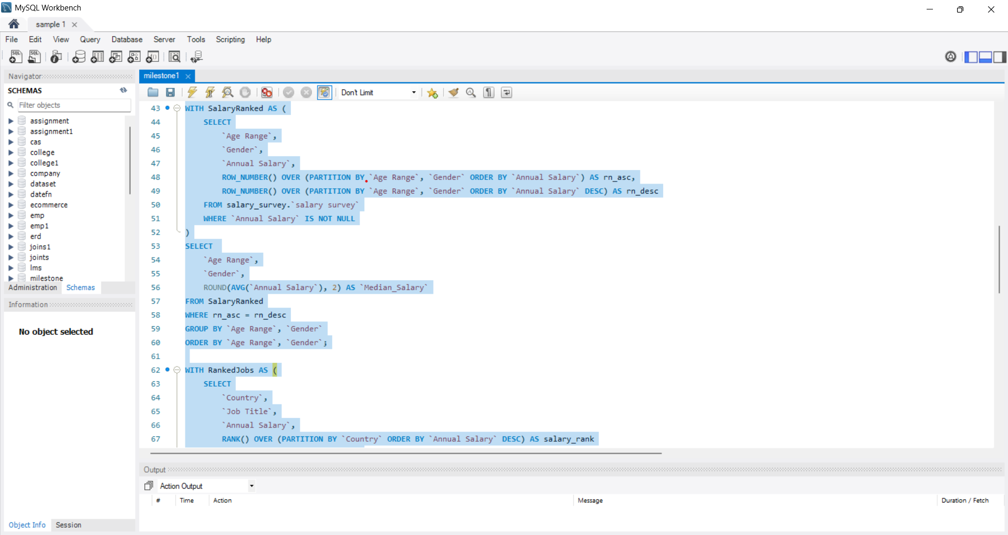
Annual salary by gender and age

Slide 11
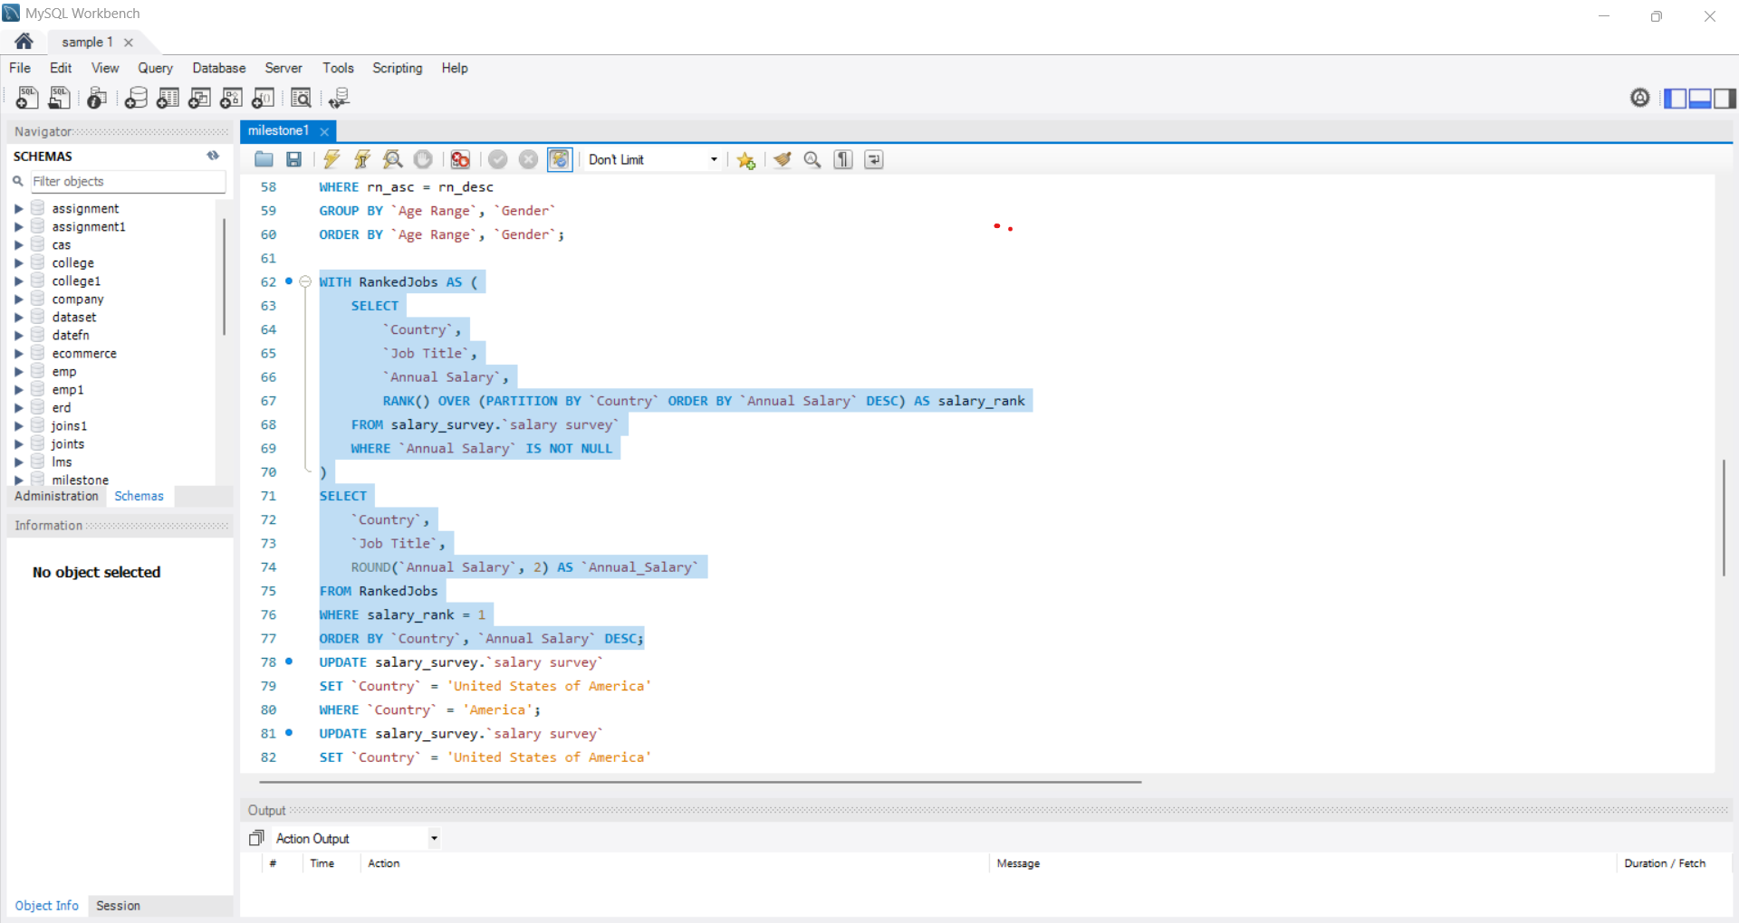
USING RANK FOR PARTITION BY COUNTRY

Slide 12
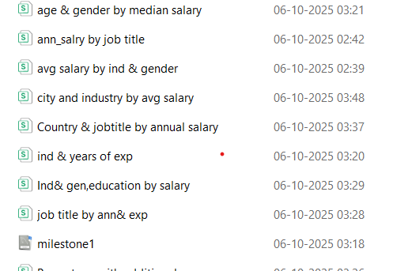
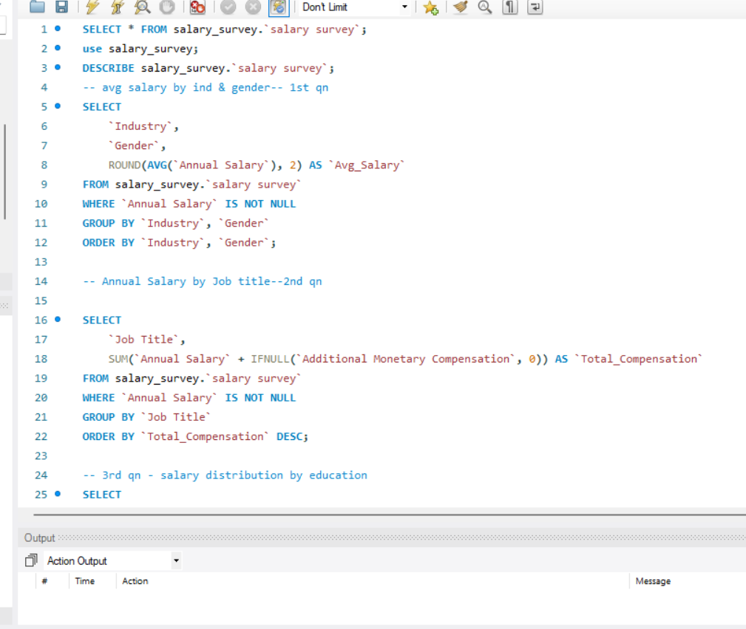
10 SQL QUERIES TO EXCEL
SQL QUERIES EXPOrTED

Slide 13
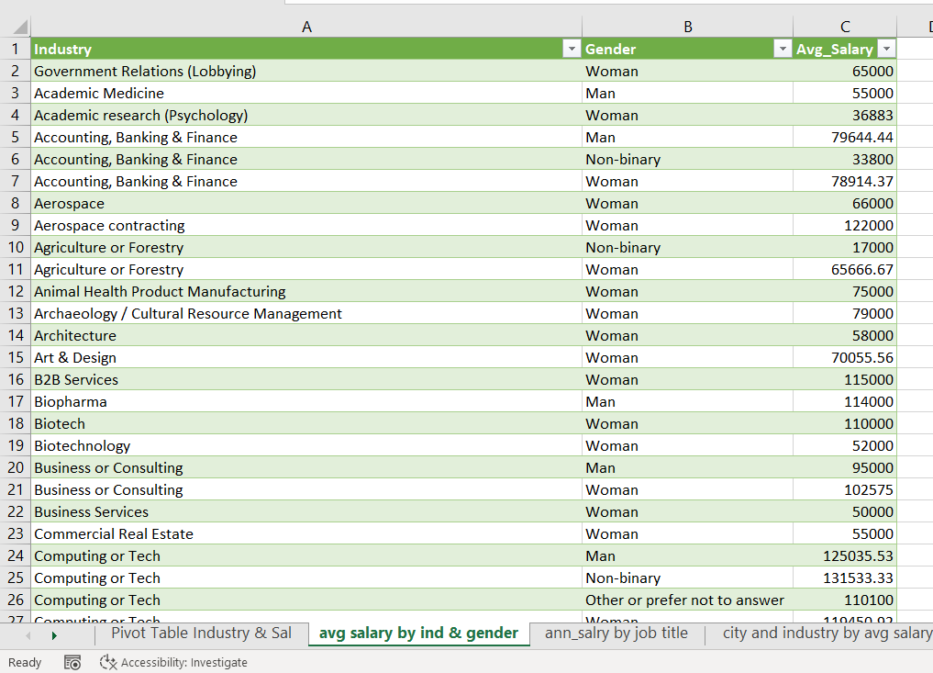
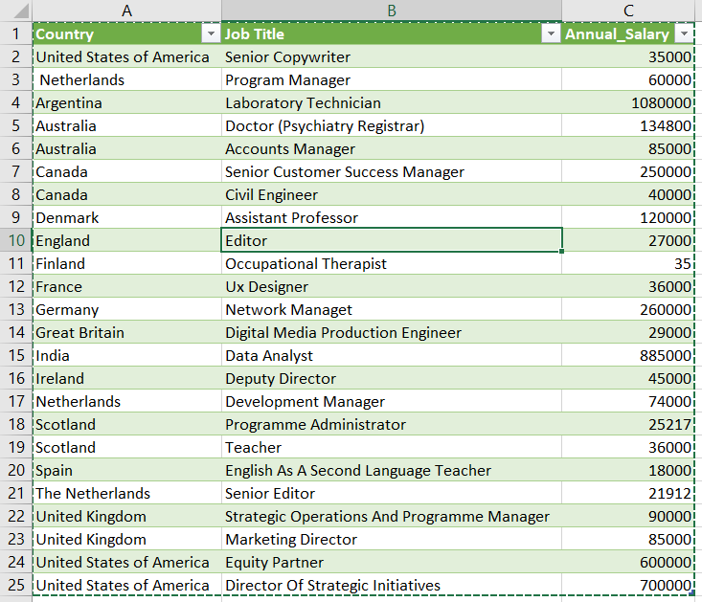
IMPORTED QUERIES TO SQL EXCEL
AvG salary by industry BY GEN
annual salARY by job & counTRY

Slide 14
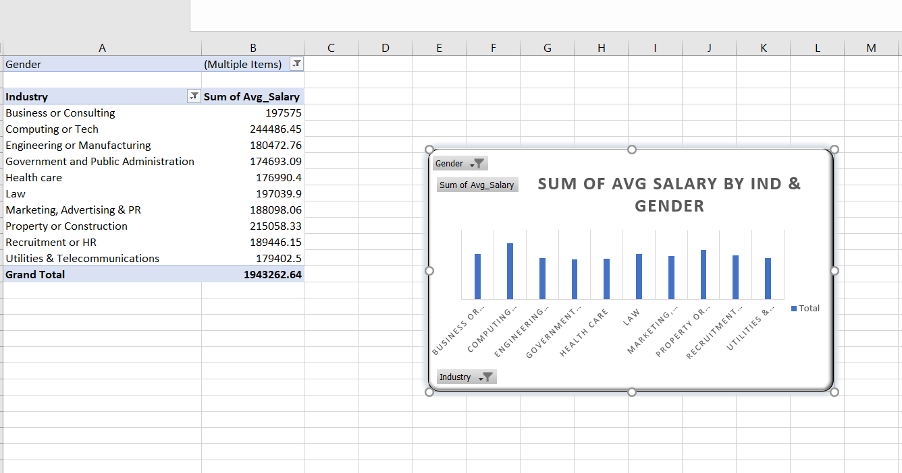
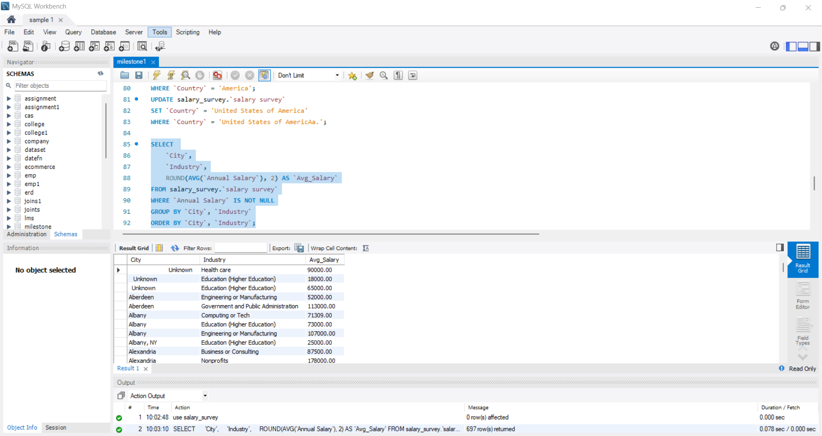
Average SaGenderlary by Industry and
PIVOT TABLE & CHART USING QUERIES

Slide 15
top 10 Industries-Average Salary by gender (men & women) – pivot charts & kpi summary
🔹 Highest Paying Industry:
Computing or Tech – ₹244,486.45
Indicates strong market demand and higher compensation for technology professionals.
🔹 Lowest Paying Industry:
Government & Public Administration – ₹174,693.09
Reflects structured pay scales and lower flexibility in public-sector salary growth.
🔹 Average Salary (Across Top 10):
₹194,326.26
Represents the overall average earning potential across major industries.
🔹 Pay Gap (Top vs Bottom):
₹69,793 difference
Shows a noticeable disparity between the highest and lowest paying industries.
🔹 Top 3 Industries by Salary: 1️ Computing or Tech – ₹244K 2️ Property or Construction – ₹215K 3️ Business or Consulting – ₹197K

Slide 16
TOTAL COMPENSATION BY JOB TITLE & KPI
KPI Summary
🔹 Highest Paying Job Title:
Laboratory Technician – ₹1,303,000
Leads all job titles in total compensation, indicating high value placed on specialized technical skills in lab environments.
🔹 Next Top Roles:
Data Analyst – ₹947,000
Project Manager – ₹864,825
Software Engineer – ₹738,000 These roles represent core analytical and management positions driving organizational success.
🔹 Middle Tier:
Program Manager (₹718K), Director of Strategic Initiatives (₹700K), Equity Partner (₹600K)
Reflect senior or leadership-level positions with strategic responsibilities.
🔹 Lower End of Top 10:
Attorney (₹571K), Editor (₹557K), Accounting Manager (₹510K)
Still within the top 10, but compensation is relatively moderate compared to technical and leadership roles.

Slide 17
SALARY SURVEY DASHBOARD

Slide 18
Insights From Dashboard:
Higher education levels (Master’s & PhD) directly correlate with higher salaries.
Engineering, Software, and Oil & Gas industries lead in compensation.
Education and Nonprofit sectors offer below-average pay.
Salary growth is steep after 5+ years of experience.
Gender gap ~8–10%, narrowing in senior positions.
Developed countries (US, UK, Netherlands) show higher median salaries.

Slide 19
KEY FINDINGS
Education matters: Higher education levels (College, Master’s, PhD) lead to significantly higher average salaries.
Experience drives growth: Professionals with 10+ years of experience earn 2–3× more than entry-level roles.
Top-paying fields: Consulting, STEM, Health Care, and Technology show the highest compensation levels.
Gender trends: Women perform strongly in STEM and Consulting, though a slight pay gap persists in traditional sectors.
Outliers: A few high salaries (>$1M) influence averages, showing executive-level representation.

Slide 20
CONCLUSION
The Salary Survey Dashboard demonstrates how SQL analysis and Excel visualization together can uncover valuable workforce insights. This project confirms that education, experience, and job title are the strongest factors influencing salary levels. Overall, the analysis supports data-driven compensation strategies, promoting transparency and informed decision-making.

Slide 21
THANKYOU

